Slide 1
Delay Events
Standardize
k-means
How many clusters? silhouette score… And other scores…
k = 5
Important features? ‘important’ if mean in a cluster > 1 (std)

Slide 2
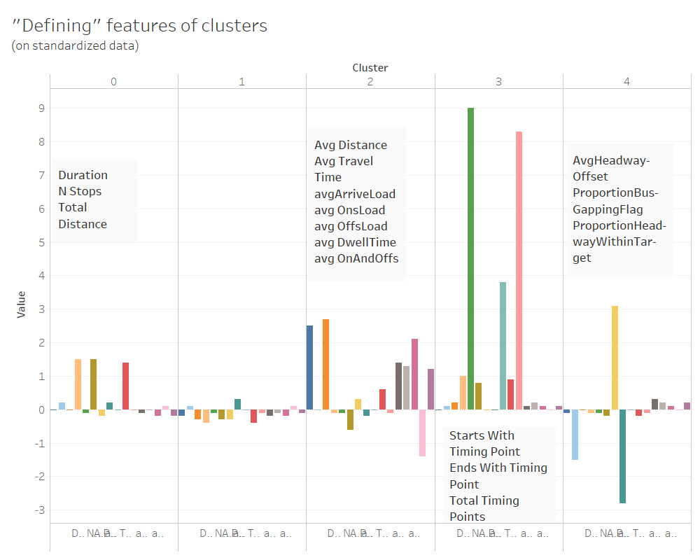

Slide 3
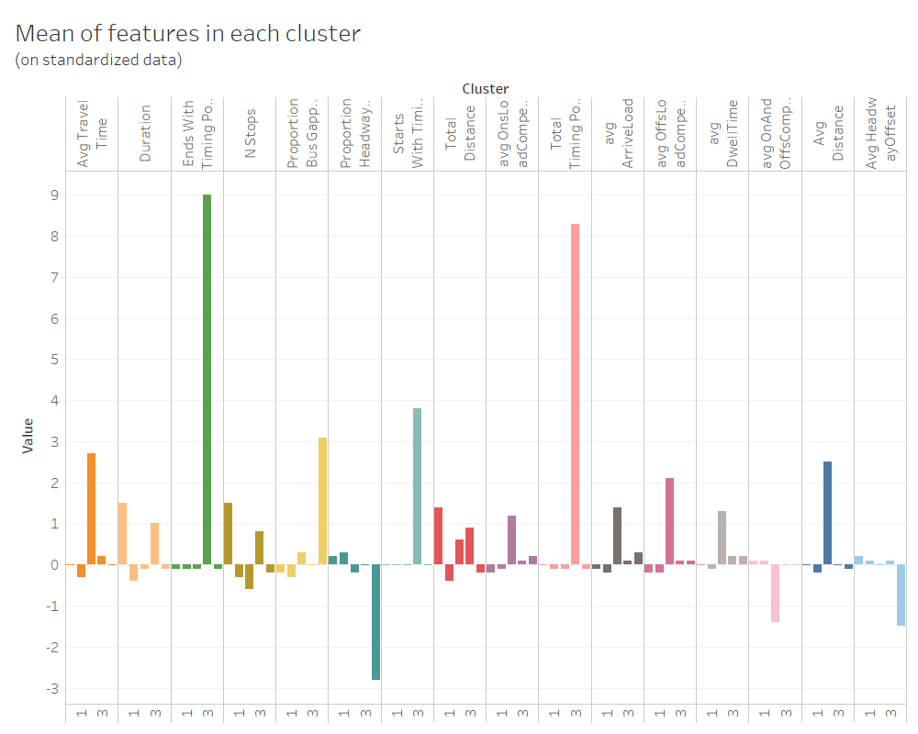

Slide 4
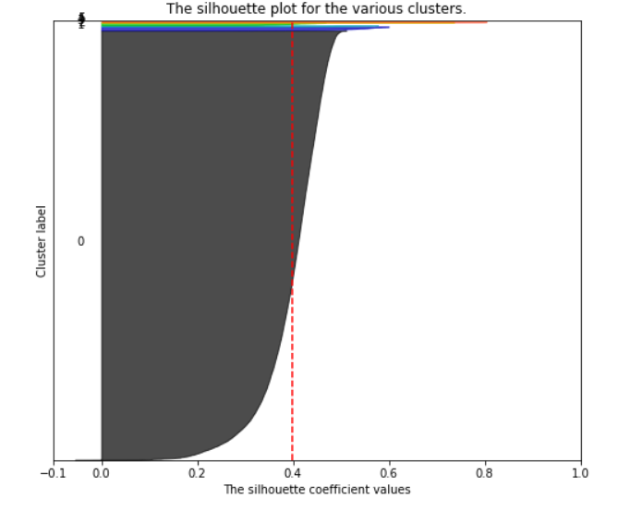
Other approaches? Yes—But all failed!
DBSCAN, OPTICS
Good silhouette score only when:
GM , BGM
k-means simply got better scores!

Slide 5
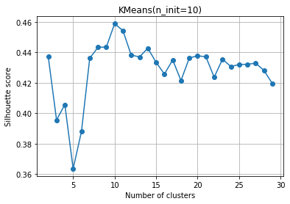
Bus Stop Locations
k-means
How many clusters? silhouette score
Tried k = 10 and k = 11
k = 10 worked great!

Slide 6
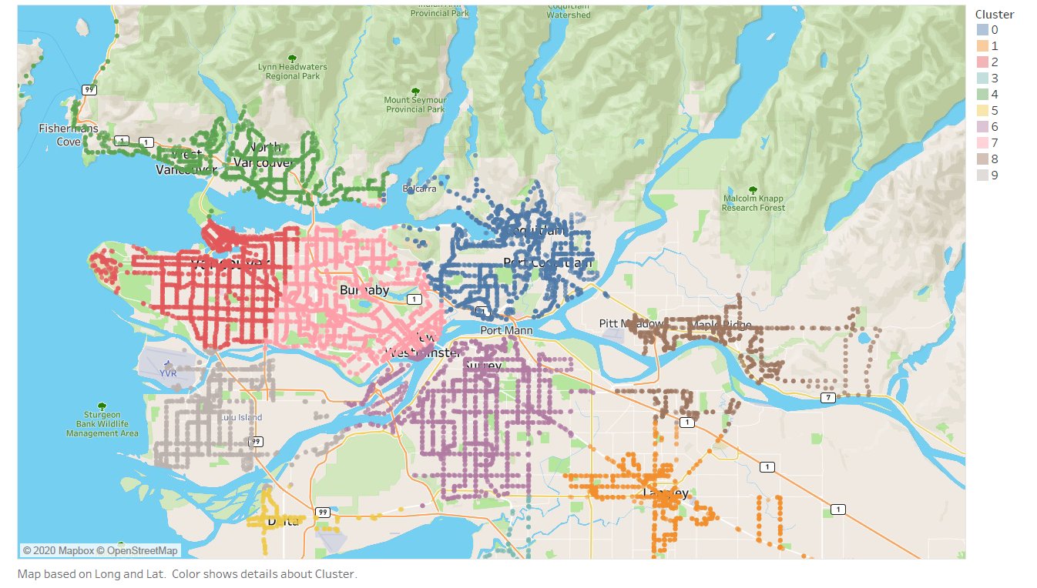
k = 10 is great!

